Slide 1
OUTPASS MANAGEMENT SYSTEM
TS- WEB PROJECT
Presented By:
1. J Dhanalakshmi
2. K Mounasree
3. S Sravya
Guided By:Mr. Poova Ragavan

Slide 2
OUTLINE
Abstract
Problem Statement
Proposed System/Solution
System Design
System Development Approach(Technology Used)
Conclusion
References

Slide 3
Abstract
Outpass is a permission that is given to students to go out of hostel mainly in instistutions.Currently many hostels are following manual work i.e., Students need to visit the warden/care taker office by in person.Our project is to reduce that manual work and paper usage by providing an online environment where students can apply for outpass and wardens and care takers can also easily accept or reject students outpass through this portal.The outpasses history will be stored in database.So,the institute can check that details when they required.

Slide 4
Problem Statement
In today’s running technology every job has become effortless, keeping this in mind a system has been designed which is helpful for colleges, universities & other educational institutes. This is designed for issuing &maintaining the out pass for students departing outside the campus assuring that they have departed with intimation to their Wardens responsible authorities. There are as many systems, which are being used for this purpose, but they work in native nature. To avoid the demerits of existing system this system is designed intelligently to serve numerous users at an instant. It is purely network-based miniature. A high-level security Issue to avoid anonymous entry to system, and to avoid worthless tapping of data.

Slide 5
Proposed Solution
So using this Outpass system for hostels where students get to take permission of Warden/care taker just by filling up a simple form. The student login’s and fills the out-pass form and waits for the reply from the authorities(caretaker/warden).

Slide 6
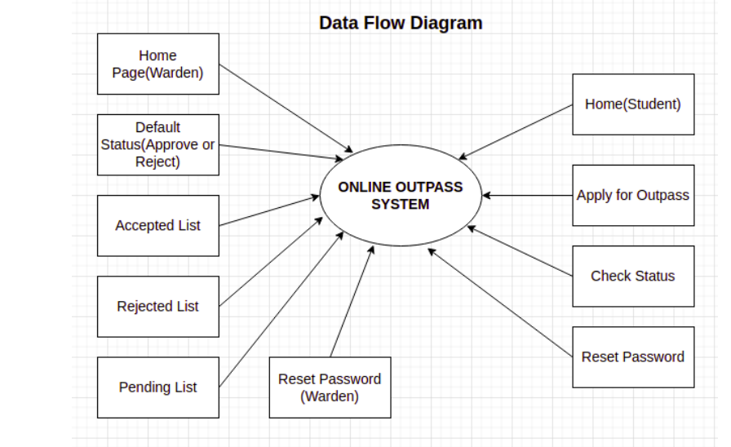
System Architecture

Slide 7
System Deployment Approach
This project is based on Web Development.This is developed by using HTML,CSS,JS,Node JS,Mango DB.
Here we have two categories Warden/Care taker and student.The Student can take permission by filling a form and warden will accept or reject that request by seeing the details of student that are stored in database.

Slide 8
Conclusion
This Online Student Outpass Management System in Node JS MongoDB project is primarily concerned with keeping track of student outpass activities. The system aids in the tracking of personal, departments, and outpass records according to available categories. In order to request for outpass days, an student must state specific things such as the sort of leave, the conditions, and the start and end dates. Warden and HOD must first create departments, then manage personal and their personal information. This is critical or students who want to request a outpass of absence, for example. The system needs the user to fill out several areas such as the user name and a brief form with a short explanation. In terms of history, the system shows all of the accessible outpass histories, together with the facts and status of each Student. Finally aim of the project is to make a complete, fully working web based outpass system for students in hostel. System to improve students everyday outpass management and to increase working efficiency.

Slide 9
THANK YOU

